Slide 1
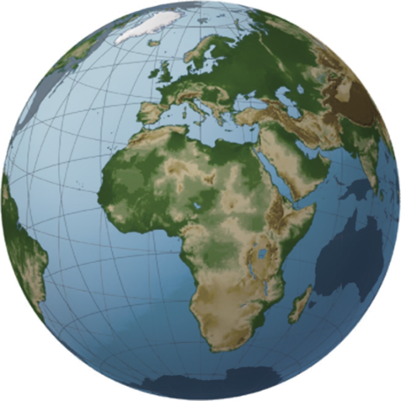
The world needs Africa to achieve the Sustainable Development Goals
… Unprecedented opportunities with the right mix of policies and resources
African Development Bank Group The voice of Africa
Stands at the moment of truth for structural economic change
Now is the time to capitalize, from a position of strength
An increasingly important destination for global investors
Abundant opportunities across multiple asset classes
Filled with opportunities that the global investment world needs
Unleashing the energy of the private sector will catalyze the region and provide much needed higher returns
Has the potential to accelerate its own transformation
The High 5s focus on the implementation of projects that accelerate this revolutionary change
An emerging region increasingly integrated into the global landscape
Ensuring that strong growth performance delivers structural change
Vast natural resources literally provide the fuel for development
A youthful and diverse continent teeming with life
By 2050, Africa will be the only region with a growing working age population
Investments needed for solutions to global climate change
7 of the 10 countries most threatened by climate change are in Africa and solutions represent opportunities
The Bank Group is uniquely poised to drive Africa’s development
1
Notes:
Initial version

Slide 2
A promising growth outlook across the continent
Best performing region, led by Ethiopia, Djibouti, Rwanda, Uganda and Kenya, fueled by agriculture and industry sectors
Encouraging projections for 2018 and 2019
Libya
70.8%
East Africa Leading the way
Senegal
6.9%
Guinea
6.7%
Burkina Faso
6.7%
Djibouti
7.0%
Ghana
8.5%
Ethiopia
8.1%
North Africa The second best performer
Egypt, Libya, Morocco and Algeria contributed substantially to regional growth, driven by economic and fiscal reforms
Positive outlook for 2018 and 2019
Cote d’Ivoire
7.6%
Rwanda
6.1%
Tanzania
6.7%
32 countries posted growth rates of 3.6% or higher
Performance dependent on commodities, hence vulnerable to price changes
Growth acceleration expected in 2018 and 2019 as Nigeria consolidate gains, and Cote d’Ivoire, Ghana and Senegal contribute to regional growth expansion
West Africa Progress in a contrasting panorama
Botswana, Madagascar, Mozambique and Zambia lead growth, but South Africa, the region’s economic powerhouse, performed below potential: services and industry sector’s contribution increased, agriculture contracted due to drought
Projections for 2018 and 2019: higher growth rates required for poverty reduction
Egypt 8.7%
Largest African economies
(% of GDP)
Nigeria 17.6%
Southern Africa Growth
below potential
South Africa 14.5%
Central Africa A modest
performance
Underperformance as output contracted sharply in Republic of Congo and Equatorial Guinea
Resilient regional economies to pave the way to improvement in 2018 and 2019
Algeria 7.4%
Sudan 5.8%
4
Most economies operating below full growth potential

Slide 3
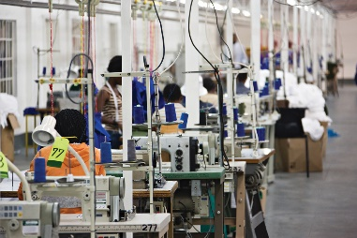
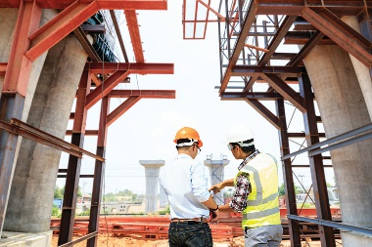
Africa, the next investment frontier
Urgent need for structural transformation to
accelerate economic diversification
Annual infrastructure needs
Annual financing gap
While the global economy boasts hundreds of trillions of dollars
of savings chasing investment opportunities
Policies to empower the poor
Job creation
Investment in infrastructure
USD 130-170 billion
USD 68-108 billion
Improve regulatory environment
Subsidize wages
Attract foreign investment
Shift toward labor-intensive industries
Modernize agricultural sector
Enter into global value chains
Critical for sustainable growth and inclusive development
Yet infrastructure finance declined in recent years
75
83
75
79
(in USD billion)
63
7
Africa has the potential to capitalize on its strengths

Slide 4
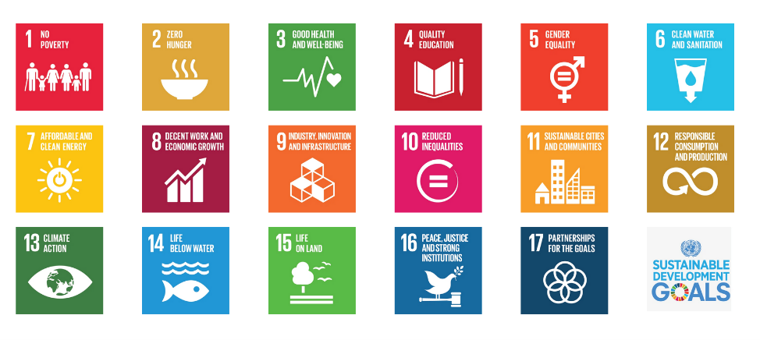
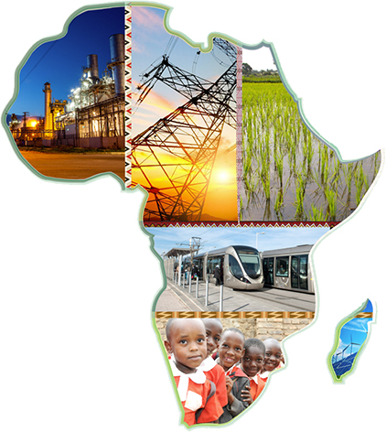
The High 5s – A compelling opportunity to accelerate Africa's transformation
If the SDGs are not met in Africa, they will not be met globally
Light up and Power Africa
Industrialize Africa
Integrate Africa
Improve the quality of life for the people of Africa
Feed Africa
Priority areas
3
4
5
7
9
13
2
5
13
5
7
8
9
12
6
9
17
3
4
5
6
8
10
11
The High 5s will help Africa achieve close to 90% of the United Nation’s Sustainable Development Goals (SDGs) and are intrinsically linked to the African Union’s Agenda 2063
Delivering on the Bank's Ten Year Strategy to achieve inclusive
growth and help Africa gradually transition to green growth
9

Slide 5
The Africa Investment Forum
Leveraging strategic alliances to scale-up private investments into the continent
Africa’s Premier Investment Market Place
November 7-9, 2018
Johannesburg, South Africa
A transactional and multi-disciplinary platform
Bringing together AfDB and global multilateral financial institutions to de-risk investments at scale
Scaling-up project preparation facilities and tools
Leveraging investments strategically into Africa
Catalyzing investments into projects to help the High 5 agenda
Promoting projects for co-investments and blended finance
Providing effective risk-mitigation instruments
Addressing policy and regulatory issues
Private sector: banks, insurance companies, private equity and venture capital firms, impact investors, pension funds, project developers
Government officials: Heads of State and Government, Ministers of Finance, Central Bank Governors, Sovereign Wealth Funds
Multilateral development finance institutions
Bridging the financing gap
Policy and regulatory environment, fostering investment-friendly regulation
Co-guarantee platform with multilateral financial institutions, export credit agencies, insurance companies to de-risk private sector investments at scale
Project preparation
Investment promotion
attracting institutional and non-traditional investors
Pipeline development
19

Slide 6
Leveraging our AAA rating to meet Africa’s needs
A diversified funding profile in multiple markets and currencies across the world
Borrowing program
(in USD billion)
Outstanding borrowings of USD 32.8 billion
(As of 31st December 2017)
Maintaining a strong track record in issuing liquid global benchmarks
Catering to the needs of Socially Responsible Investors
Deepening and widening our investor base across the world
Promoting African capital markets
“AfDB’s funding profile remains very diverse in terms of investor base, currency and maturity” Standard & Poor’s, July 2017
39
Attracting competitive funding levels for the benefit of the continent

