Slide 1
AFRICA INVESTMENT FORUM Africa’s Investment Market Place Mrs Stella Kilonzo Senior Director, Africa Investment Forum Office of the President June 2018

Slide 2
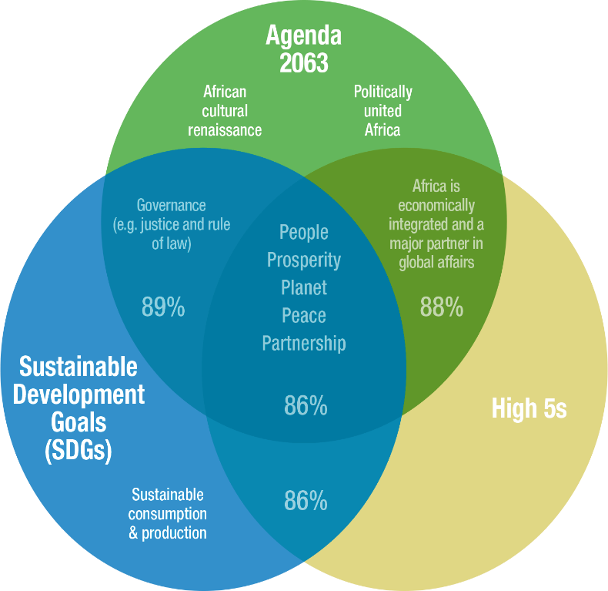
Africa’s Development Landscape
Africa’s Investment Market Place
Average annually
Light up and power Africa
$65–90 billion
Approx. $170 billion per annum
The High 5s will accelerate progress towards the SDGs
According to a UN report, the High 5s will contribute to achieving almost 90% of the SDGs in Africa.
Feed Africa
$32–40 billion
Industrialize Africa
$40 billion
Integrate Africa
$10 billion
Improve the quality of life
$5.5 billion
TOTAL
$153–186 billion
The global development agenda is ambitious
The international community has asked the MDBs to scale up their operations and go from “billions to trillions” to help the planet achieve the SDGs.
At the same time, Africa’s financing gap continues to expand
This gap cannot be addressed by MDBs and Governments only. It requires broad based partnerships and collective effort with the private sector to leverage capital at scale.
The MDBs/DFIs are maximizing their current resources; however, constraints imposed by prudential ratios will limit their lending capacity.

Slide 3
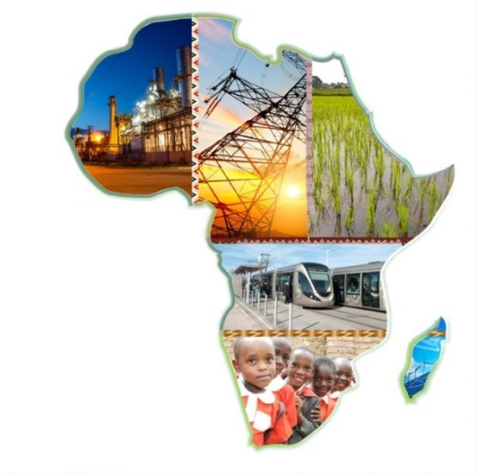
Where is the Capital?
Africa’s Investment Market Place
USD 84.9 trillion in Global Assets Under Management (AUM) and projected to doube to USD 145 trillion by 2025
USD 7 trillion managed through 94 sovereign wealth funds in 60 countiries
USD 500– 550 billion in combined net assets from African pension funds and sovereign wealth funds & projected to reach USD1 trillion by 2030
Net banking assets of circa USD 800 billion in Sub-Saharan Africa (SSA) alone.
AIF
AIF
AIF
AIF
13
13
12
1
AIF is a leveraging platform that will tilt the balance of capital towards Africa’s critical sectors to achieve the SDGs, High 5s and Agenda 2063

Slide 4
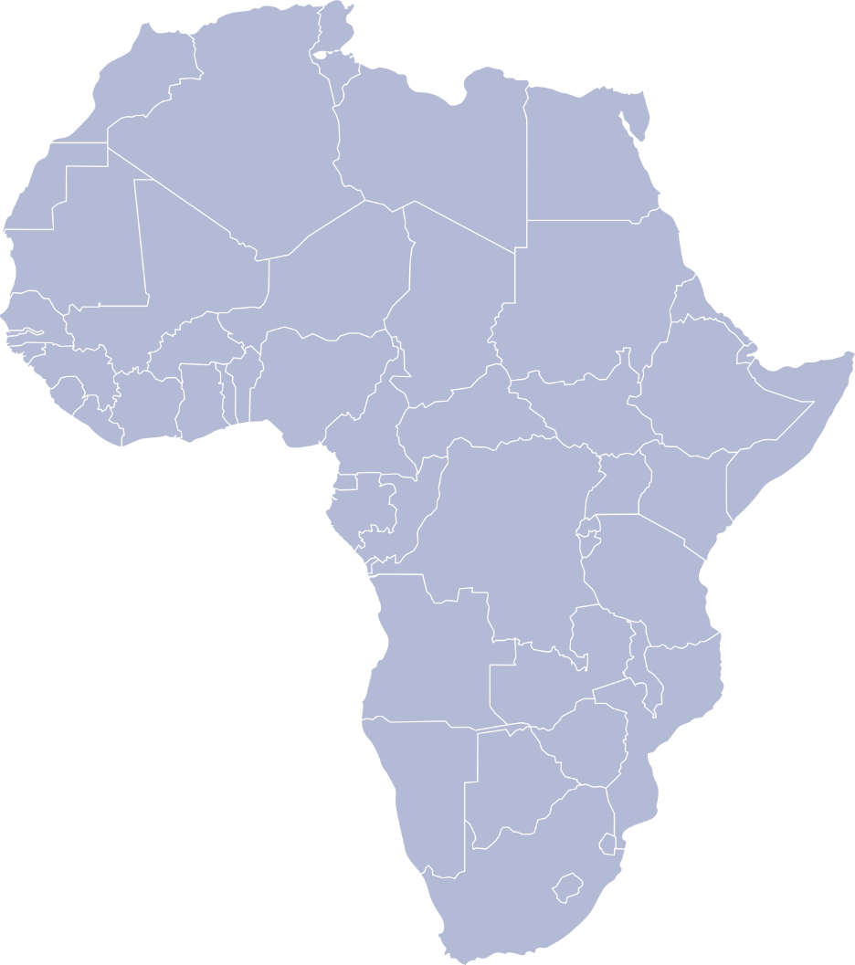
Why hasn’t this happened?
Africa’s Investment Market Place
Information Asymmetry
Investment Risk
Limited information on African markets
Data paucity
- Negative perception of investment risk
- Limited availability of tools for credit enhancement and risk coverage
Africa struggles to
attract significant capital
Dearth of Bankable projects
Business & Regulatory Environment
- Poor preparation and packaging of project proposals
- Limited availabilty of finance for project preparation
- Adverse government actions and unpredictability
- Cumbersome business regulations

Slide 5
Africa Investment Forum (AIF) – Strategic Intent
Africa’s Investment Market Place
Advance projects to Bankable stage
SPECIFIC OBJECTIVES
Capital raising
Accelerate financial closure of deals
Pipeline Development
Project Preparation
Policy Environment
Project Bankability
Investment Promotion
WORKSTREAMS
Visibility
Deal screening
Funding - Grants
Process harmonization
Regulatory reforms and consistency
Advocacy efforts for institutional building
Credit enhancement
Co-guarantee Platform
Partner engagement
Market Intelligence

Slide 6
What is the AIF?
Africa’s Investment Market Place
An enabling mechanism for MDBs/DFIs to do more with less
The Platform
The Market Place
The Market-Days
AIF
AIF
AIF
AIF
Totally transactional
Efforts that culminate into the success of the market-days
Connecting investors, other
market players and policy makers
A) Deal onboarding
- Digital platforms e.g Source & Convergence, ConnectAmerica
B) Deal screening & filtering
- Deal profile: private sector centric, demonstration effect, scalable etc)
- Deal types (Elephants, Zebras, Cheetahs, Turtles)
C) Improving deal quality at entry
- Leveraging existing and new Instruments
- Mapping potential deal partners
Investment promotion
- Roadshows
- Investor conference calls
B) Match-making investors and transactions
C) Partner engagement & crowding-in.
Sessions:
Speed-Dating
In the Board Room
Sharing success stories
Connect
Engage
Close

Slide 7
AIF PROJECT PIPELINE
Africa’s Investment Market Place
Snapshot of Investment Sectors and Opportunities Across Africa
Sector | No of Deals | Total Amount (USD Mln) | Countries | Elephants (> US$500 Mln) | Zebras (US$ 30 Mln - 500 Mln) | Cheetahs (< US$ 30 Mln)
Agriculture | 18 | 4,722 | 10 | 4 | 10 | 2
Energy | 20 | 34,086 | 10 | 5 | 11 | 1
Infrastructure | 8 | 3,874 | 5 | 3 | 4
Hospitality & Tourism | 6 | 1,817 | 6 | 1 | 5
Industrial & Trade | 3 | 3,050 | 3 | 1 | 2
Urban Development & Real Estate | 1 | 206 | 1 |  | 1
Social - Education & Health | 2 | 241 | 1 |  | 2
TOTAL | 58 | 47,996.84 | 24 Countries | 14 | 35 | 3

Slide 8
AIF PROJECT PIPELINE Cont’d
Africa’s Investment Market Place

Slide 9
AIF PROJECT PIPELINE Cont’d
Africa’s Investment Market Place
 | Angola | Burkina Faso | Burundi | Chad | Cote d'Ivoire | Djibouti | Eritrea | Gabon | Kenya | Lesotho | Madagascar | Malawi | Mauritius | Morocco | Mozambique | Multinational | Nigeria | Rwanda | Senegal | Sudan | Swaziland | Togo | Tunisia | Zambia | 24 Countries
Agriculture | 1 | 1 |  |  |  |  |  | 2 |  |  | 1 | 1 |  | 1 |  | 3 | 1 |  |  | 2 |  | 1 |  | 1
Energy |  |  |  | 1 | 2 |  |  | 4 | 1 |  | 1 |  | 1 |  | 2 | 2 | 3 | 1
Infrastructure |  |  |  |  |  | 2 |  | 1 |  |  |  |  |  |  |  |  | 1 | 1 |  |  |  |  | 2
Hospitality & Tourism |  |  | 1 |  |  | 1 |  |  | 1 |  |  |  |  |  |  |  |  | 1 |  |  | 1 |  |  | 1
Industrial & Trade |  |  |  |  |  |  | 1 |  |  | 1 |  | 1
Urban Development & Real Estate |  |  |  |  |  |  |  | 1
Social – Education & Health |  |  |  |  |  |  |  | 2
No of DEALS | 1 | 1 | 1 | 1 | 2 | 3 | 1 | 10 | 2 | 1 | 2 | 2 | 1 | 1 | 2 | 5 | 5 | 3 | 1 | 2 | 1 | 1 | 2 | 2

Slide 10
What success will look like for the AIF
Africa’s Investment Market Place
V
V
V
V
Assist MDBs/DFIs in achieving deal closure through co-financing and syndication in the marketplace
Leveraging MDBs/DFIs comparative advantage (as key conveners and honest brokers) to further consolidate their trusted relationships and brand equities
Contribute to closing Africa’s investment gap
Effective tracking of deals to follow through on transaction delivery

