Slide 1
Blair Colliver
Director of International Programs

Slide 2
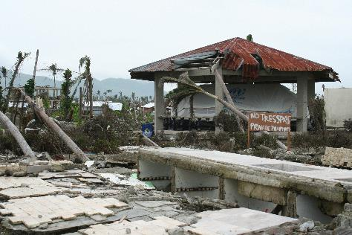
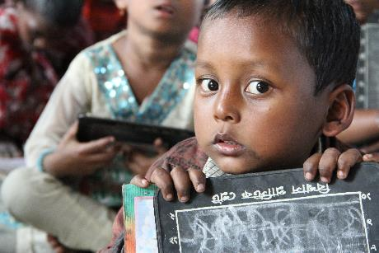
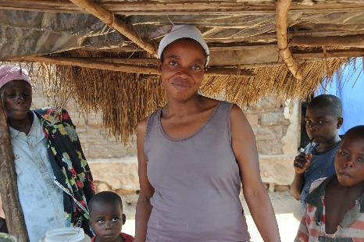
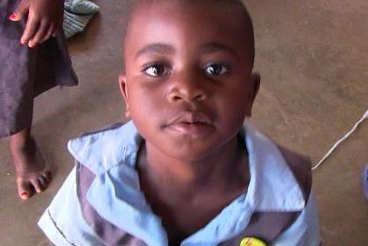
Crisis Response
Food Assistance
Community Development
ChildCARE Plus

Slide 3
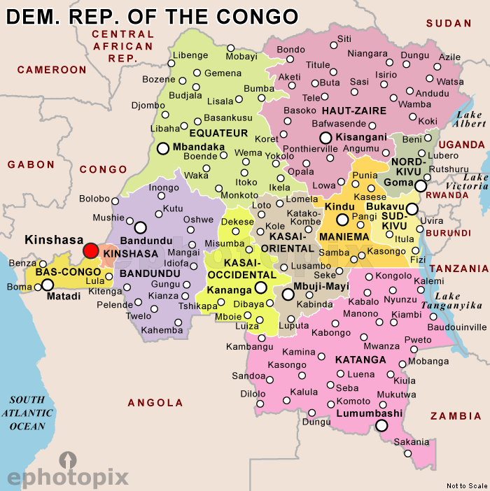
Microfinance

Slide 4
Risk Mitigation

Slide 5
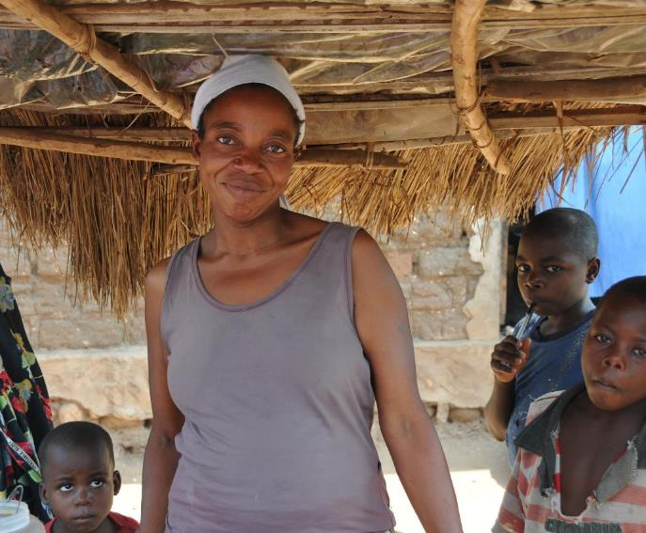
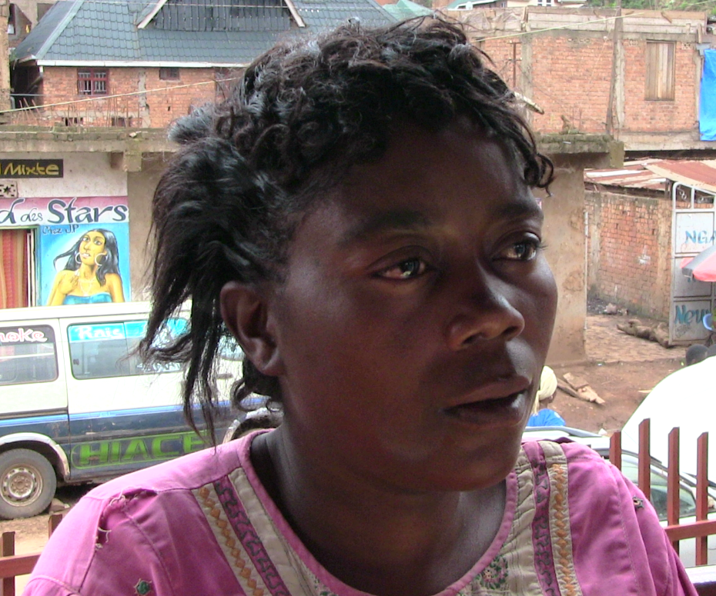
Risk Mitigation

Slide 6
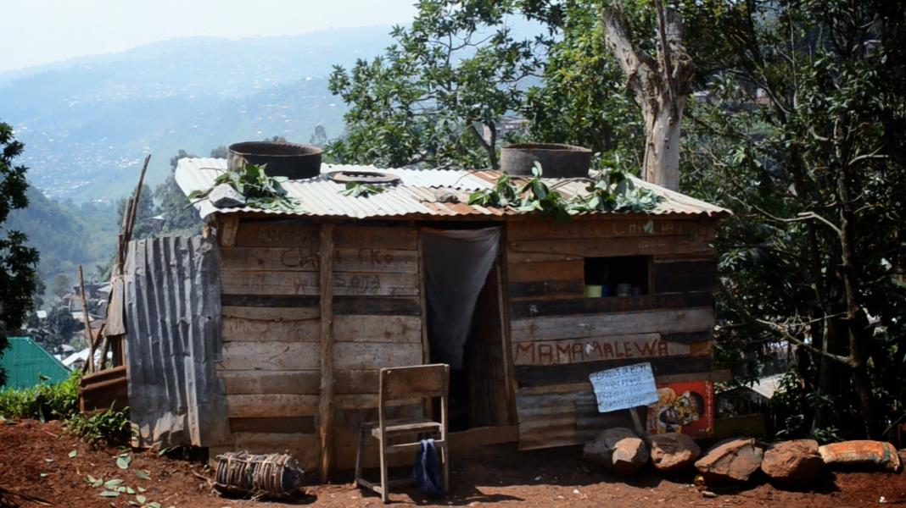
Risk Mitigation
Industry
Covenant
Services
Safety

Slide 7
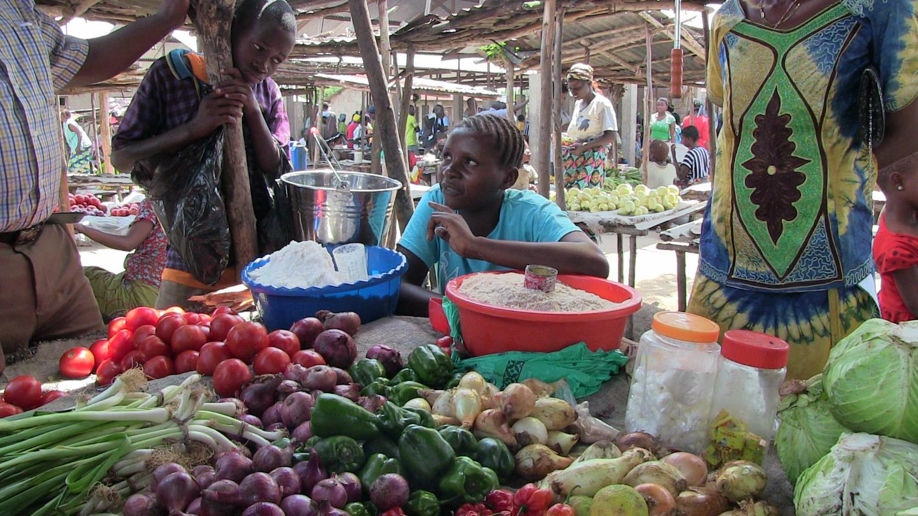
Corporate Social Responsibility

Slide 8
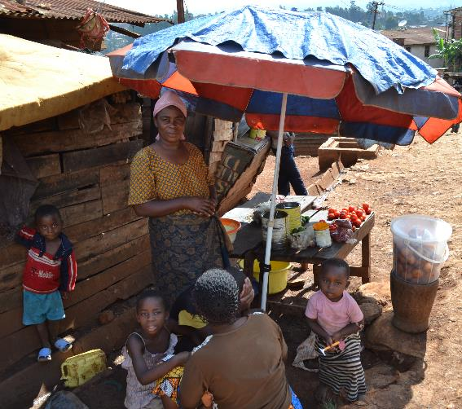
Corporate Social Responsibility
Borrowers

Slide 9
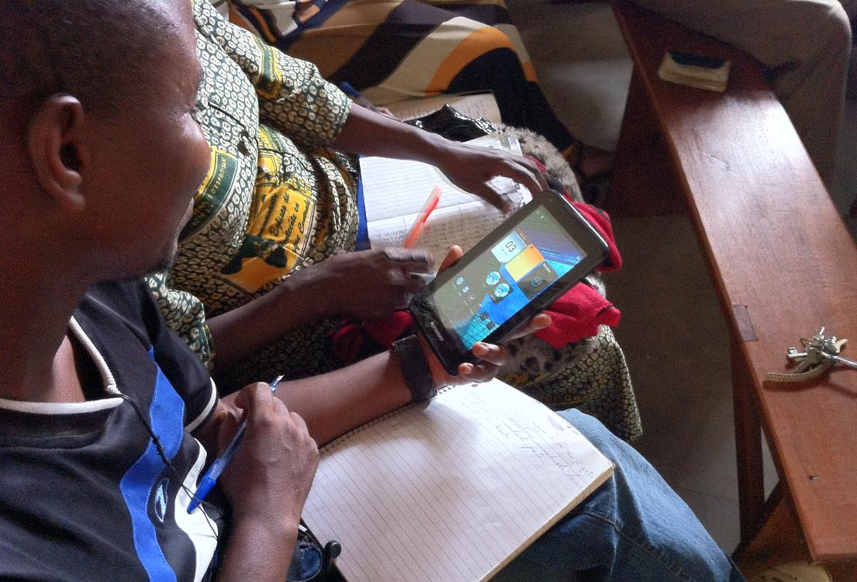
Corporate Social Responsibility
Program Partners & Community

Slide 10
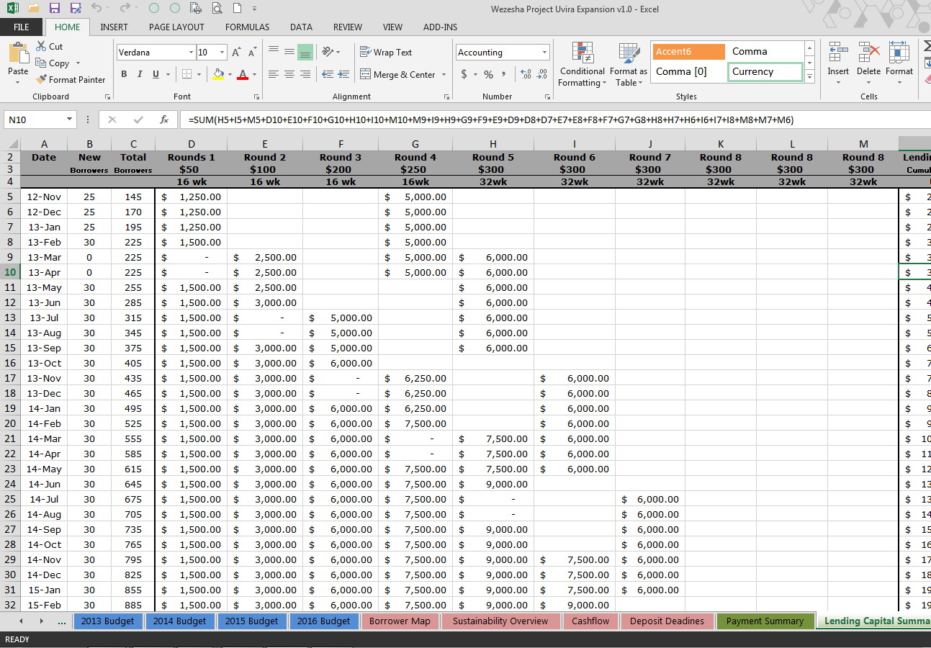
Corporate Social Responsibility
Donors & Supporters

Slide 11
Q&A

